Slide 1
Web Apps Architecture
Pravin Y Pawar

Slide 2
Web Apps Architecture
Why?
For years, businesses are maintaining their website
Without knowing anything about web apps architecture
Possible because of players like GoDaddy etc. which provides web hosting capabilities
Web apps are required when
content needs to be dynamic
Complexity is involved – databases , persistence storage comes in
more control required on the content
Then start feeling need of way to organise the things In better manner
Then Comes in Web Apps architecture!
Conventionally two tier – client server
But can be easily extended to – n tier

Slide 3
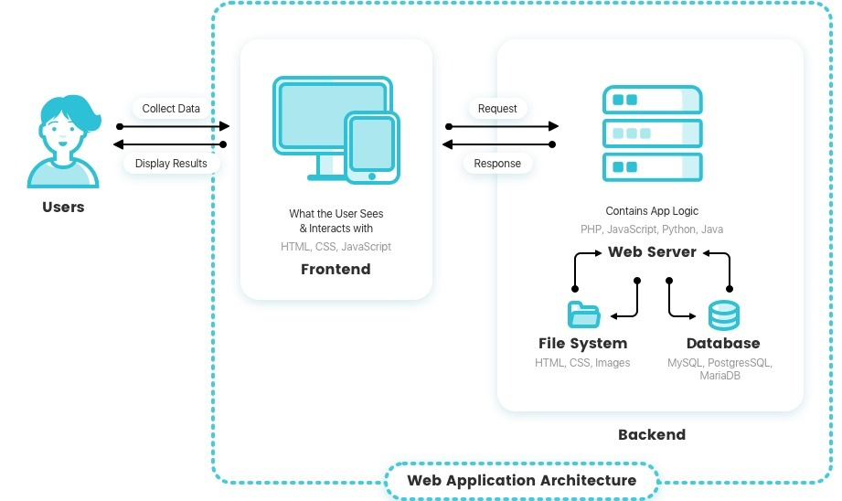
Web Apps Architecture(2)
Consists of many components
user interfaces
server side
databases
Web application architecture is used to logically define the relationships and manner of interactions between all of these components for a Web app
Source

Slide 4
Web App Components
Frontend , Backend and Databases
Typically Web application consists of a front-end, a back-end and databases
The front-end (the client-side)
Whatever the user sees and interacts within inside their browser
The main purpose of the client-side is to interact with users
HTML, CSS, and JavaScript
Back-end (the server-side)
Not visible to the users - stores and manipulates data
Accepts and fulfills the HTTP requests which essentially “fetch” the data (text, images, files, etc.) called for by the user
PHP, Java, Python, JavaScript
Databases
Usually Relational Database Management Systems (RDBMS) are used to store the data in structured format
Backend interacts with Databases to fetch the required data

Slide 5
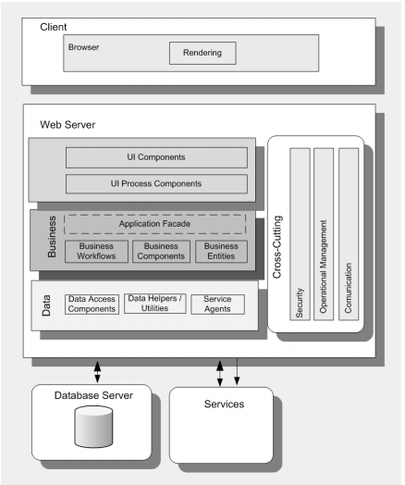
Common Web App Architecture
The core of a Web application is
its server-side logic
The Web application layer itself can be comprised of many distinct layers
Typically a three-layered architecture
comprised of
Presentation
Business
data layers
Source : MS Web Application Architecture Guide

Slide 6
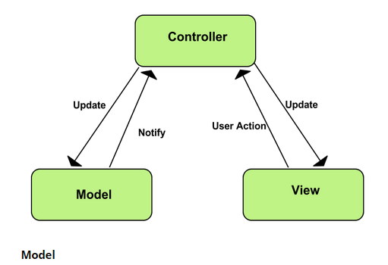
Model – View – Controller Architecture
MVC
Software design pattern commonly used for developing user interfaces that divides the related program logic into three interconnected elements
Model
View
Controller
Supported well in JavaScript, Python, Ruby, PHP, Java, C#
Model
responsible for managing the data of the application
Accepts user input from the controller
View
means presentation of the model in a particular format to the user
Controller
responds to the user input and performs interactions on the data model objects
Receives the input, optionally validates it and then passes the input to the model
Source : Google Chrome

Slide 7
Trends in Web Application Architecture
SSR , CSR
Server-Side Rendering (SSR):
Conventional approach
Separate request - response cycle for each activity carried out on by user on browser
When clicking a URL
a request is sent to the server
server processes request
the browser receives the files (HTML, CSS, and JavaScript) and the content of the page and then renders it
Repeated for every request
Client-Side Rendering (CSR):
Only a single request will be made to the server to load the main skeleton of the app
Content is then dynamically generated using JavaScript
Aka Single Page Applications

Slide 8
Comparison
SSR Vs CSR
 | Server Side Rendering | Client Side Rendering
Suitable for | Rendering apps with more static content | More dynamism is involved
Initial load time | Initial loads are faster | Initial loads are slow
Request – Response behavior | Full request – response cycle for each action | After initial load, response comes in fast or computed locally
Technologies | Conventional like JSP, Java, PHP etc. | Modern Web App Frameworks like Angular

Slide 9
Thank You!
In our next session:

